Slide 1
From image registry to chart repository
jiangd@vmware.com
KubeCon Shanghai 2018

Slide 2


Project Harbor
A brief history …
2016. 3
Management UI
Role Based Access Control
Started as an image registry
2016. 9
LDAP integration
Image replication across instances.
~1000 stars
2017. 4
https://github.com/goharbor/harbor
Content trust.
~2000 stars
2017. 9
Accepted by CNCF!
Image scanning.
Project level control policy.
2018. 4
Label support
Stateless Job service

Slide 3

Embrace kubernetes and cloud native
+
Helm is the standard for package deployment and management.
Effective approach for running Enterprise application on top of Kubernetes.
Single pane for Kubernetes users
Provide consistent user experience for both Helm chart and image management.
Harbor as the “Kubernetes Registry”

Slide 4
Integrated of Chartmuseum (diagram)
Portal
Container Runtime
Helm CLI
Introduce Chartmuseum for storage and index of helm charts.
Adaptable to multiple storage backends.
Leverage “project” as the container of helm charts.
Same RBAC rules apply to both images and helm charts.
Enhanced the “push” plugin to improve integration workflow.
Authn/Authz
Harbor API proxy
Registry
Chart museum
File system
S3
Object Storage
……

Slide 5
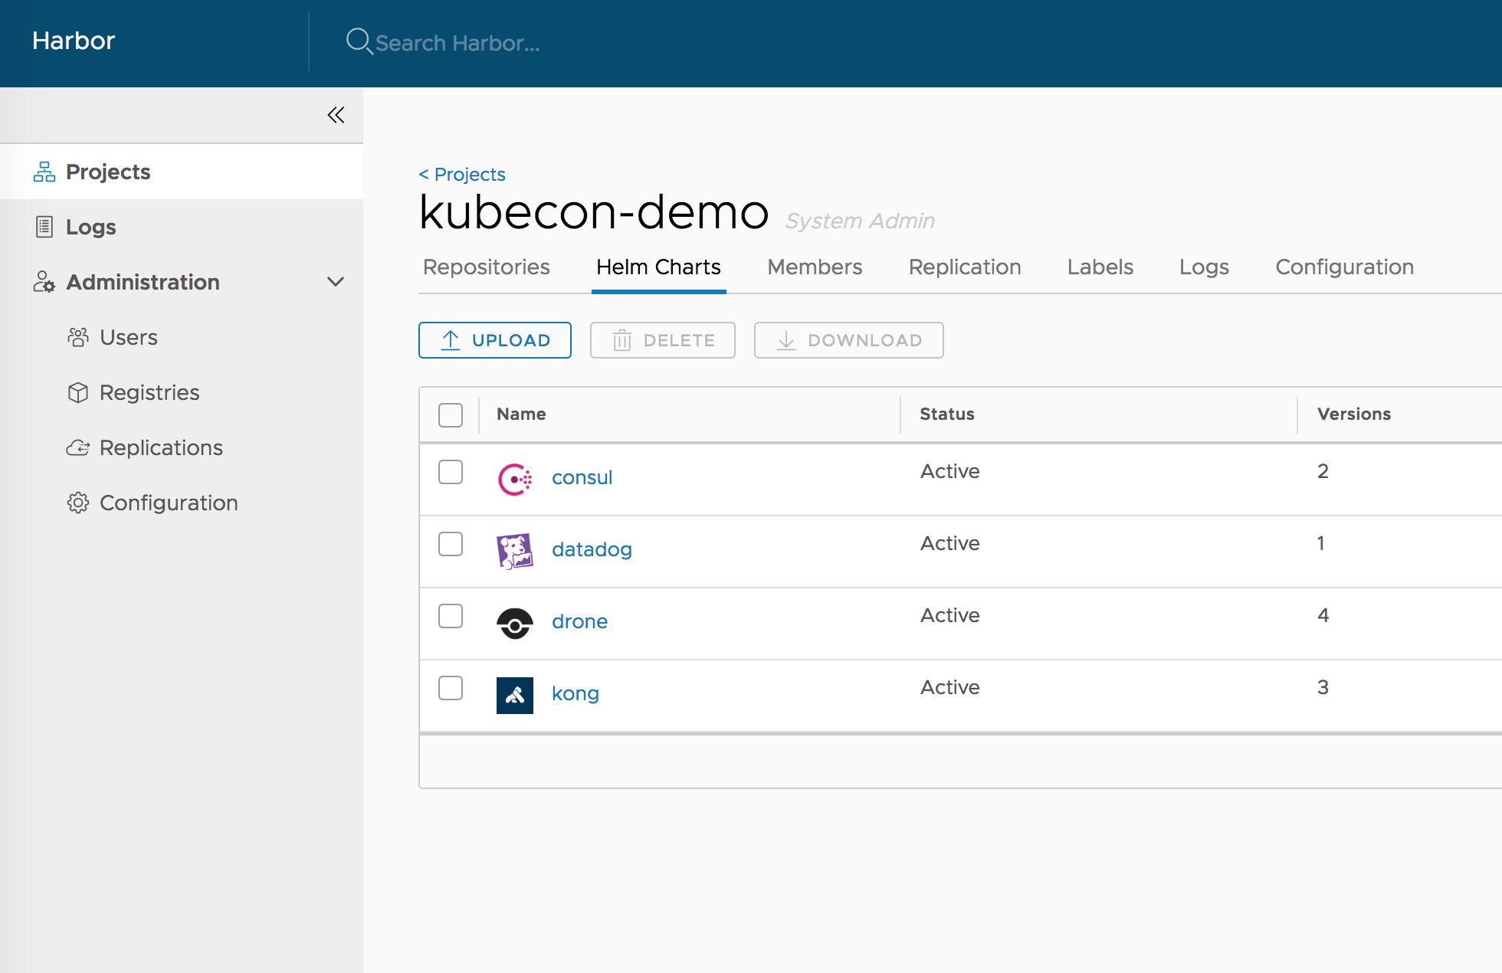
How it looks like

Slide 6
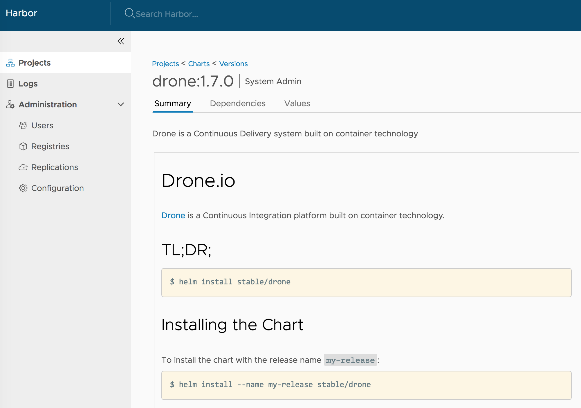
How it looks like

Slide 7
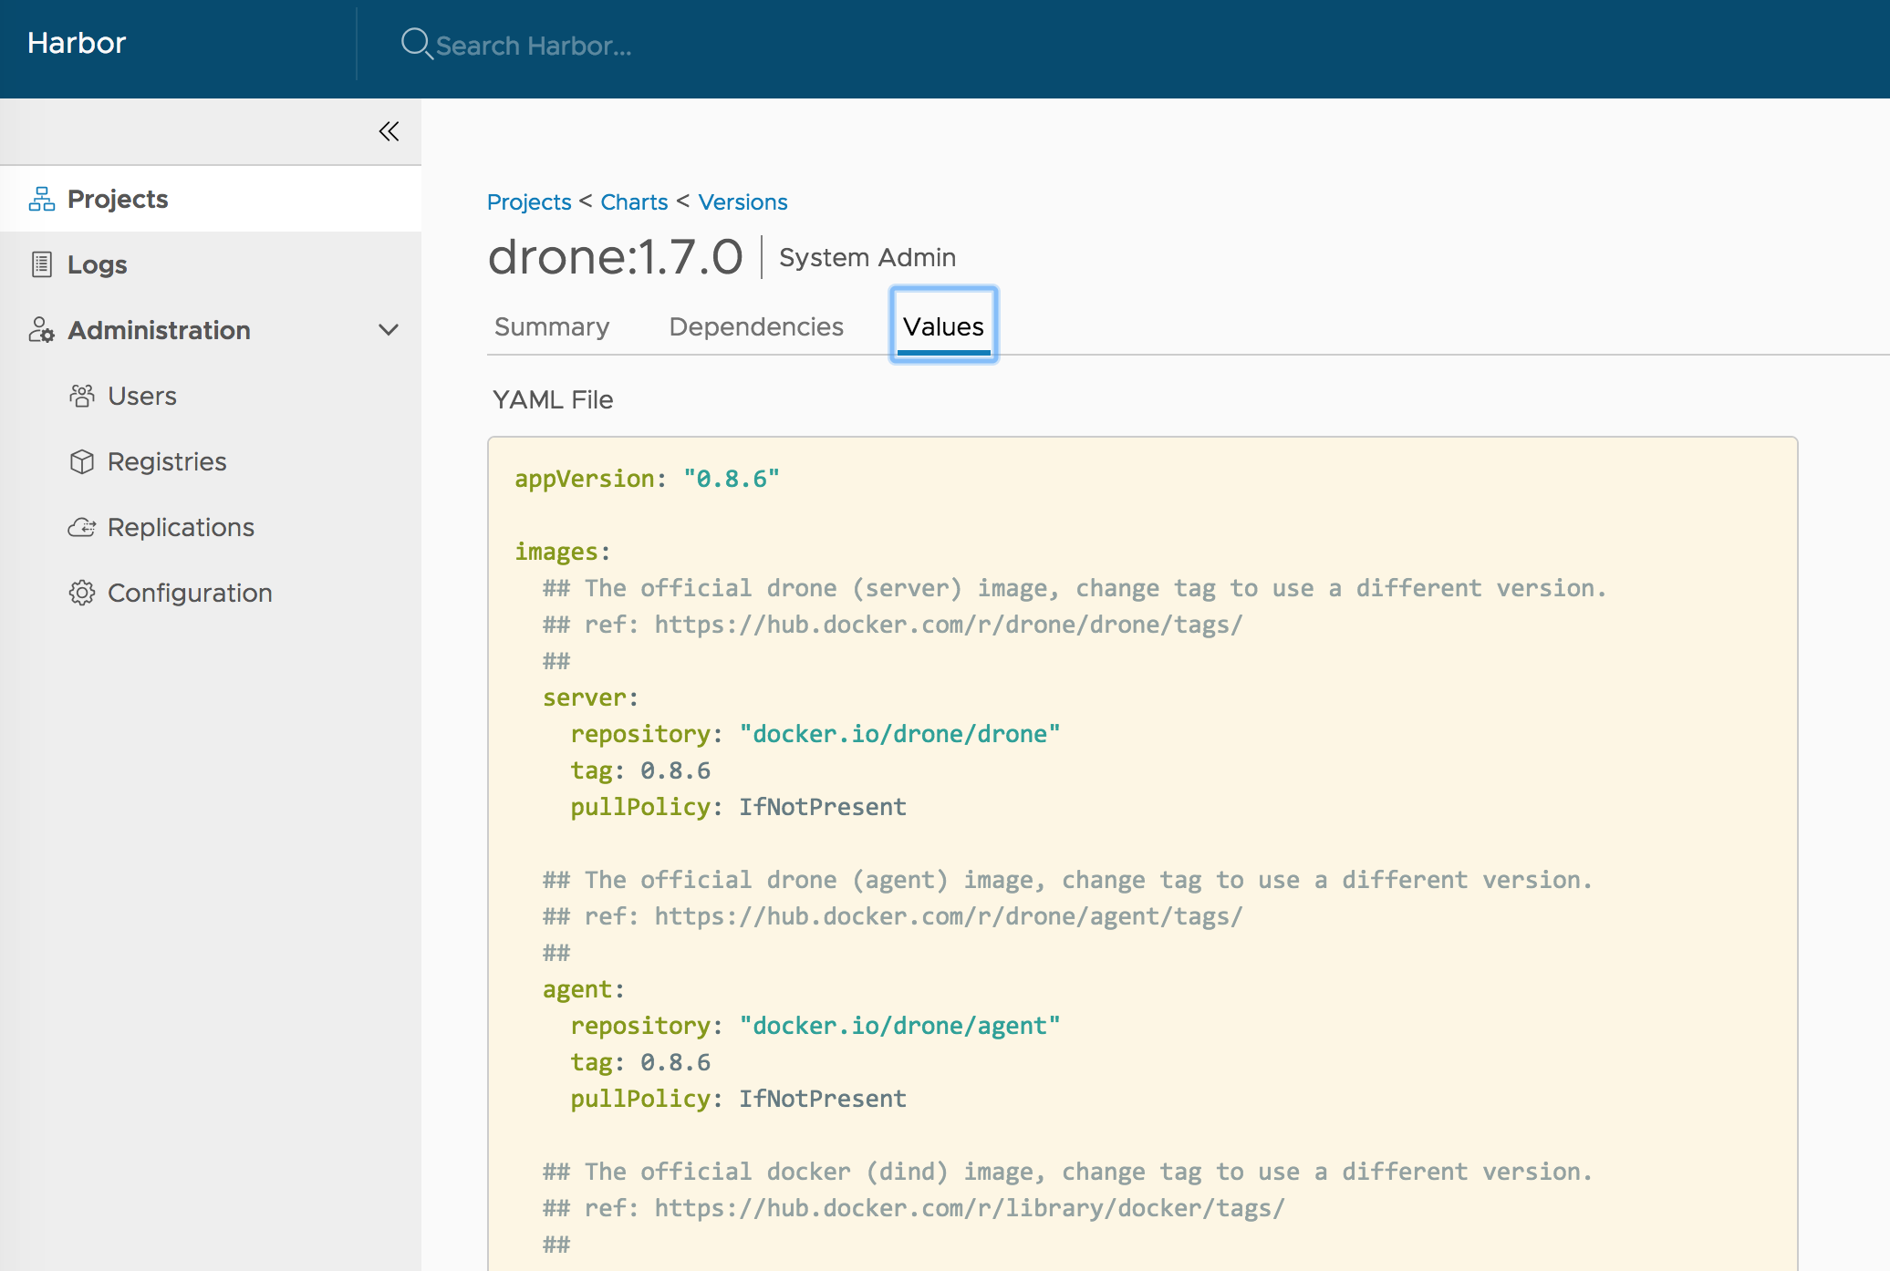
How it looks like

Slide 8
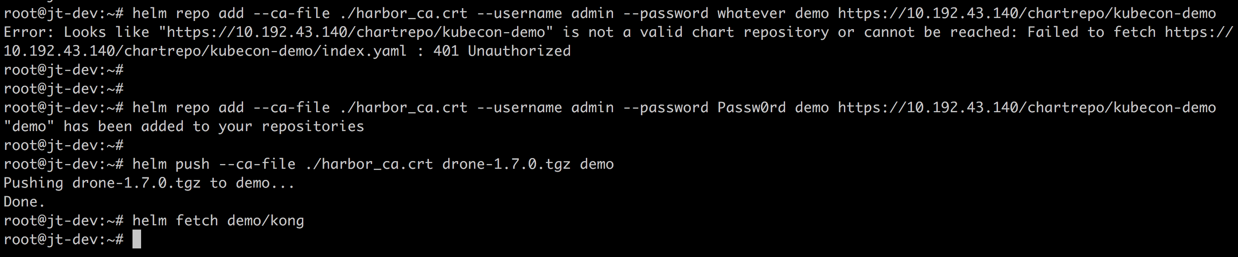
How it looks like

Slide 9
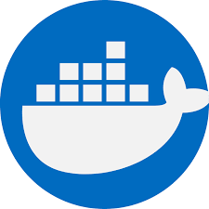
The challenge …
Flexible reference:
??
Helm chart is not self-contained.
So what images will be deployed?
Overwritable during installation:
Replication
TRUST
Vulnerability SCAN

Slide 10
Thank You

